Slide 1
YouTube Trending Videos Analysis
BU-MSSP
Yifeng Luo

Slide 2
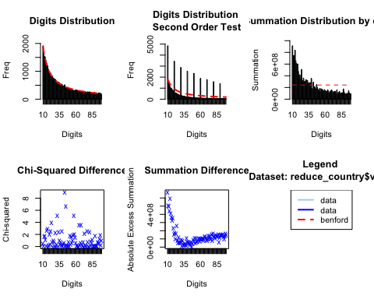
Benford’s Law for video views

Slide 3
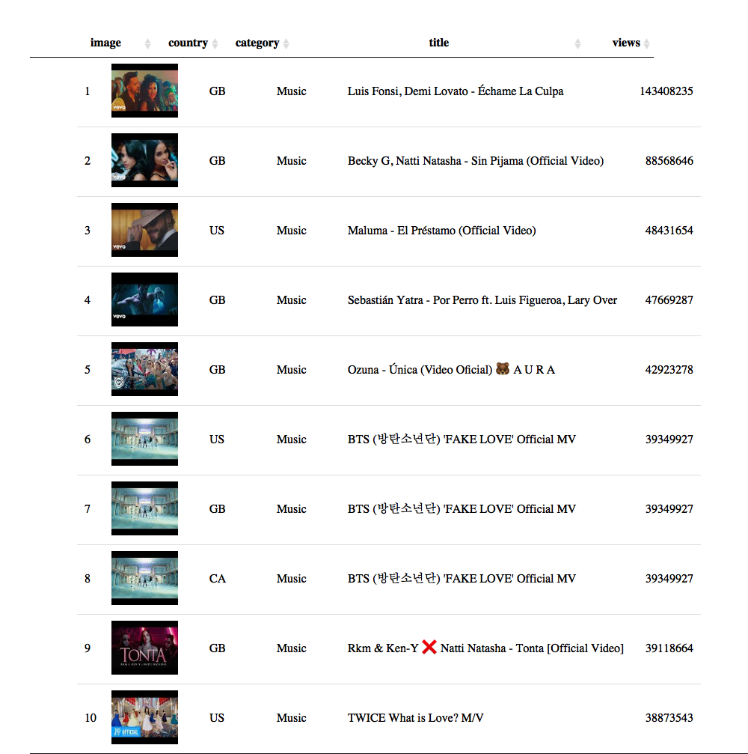
Top 10 views of trending videos

Slide 4
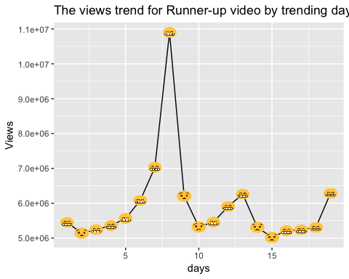
The movement of views increment by trending days

Slide 5
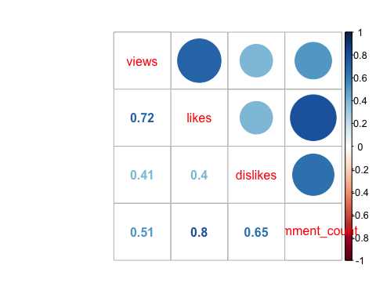
The correlation of the amount of view, like, dislike and comment

Slide 6
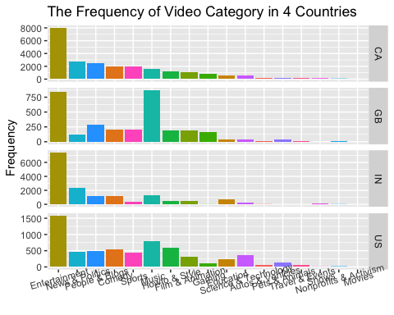
The difference of the frequency of video category among countries

Slide 7
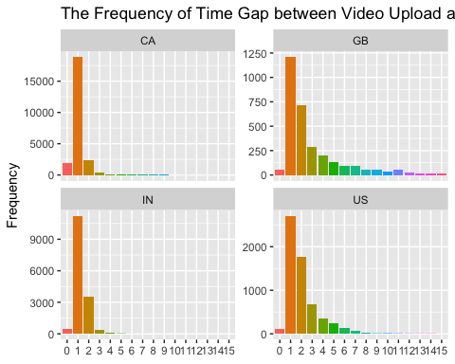
The distribution of time gap between video uploading and trending

Slide 8
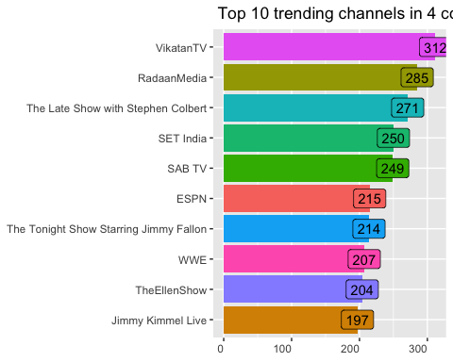
Top 10 trending channels in 4 countries

Slide 9
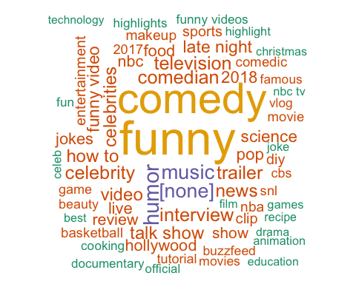
US-Tags ‘comedy’ ‘funny’ ‘hollywood’ ‘nba’

Slide 10
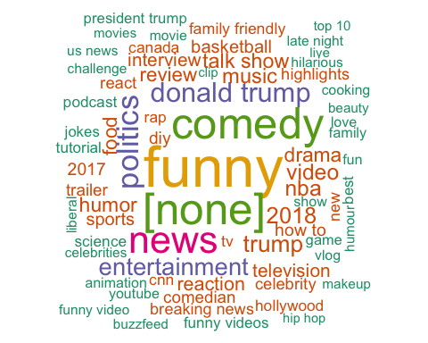
CA-Tags ‘donald trump’ ‘trump’ ‘[none]’ ‘politics’

Slide 11
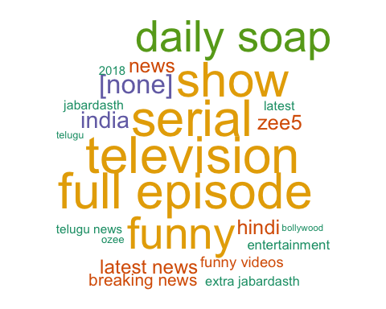
IN-Tags ‘full episode’ ‘daily soap’ ‘hindi’ ‘bollywood’

Slide 12
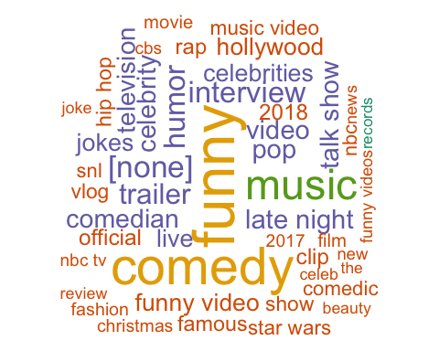
UK-Tags ‘music’ ‘pop’ ‘trailer’ ‘rap’

Slide 13
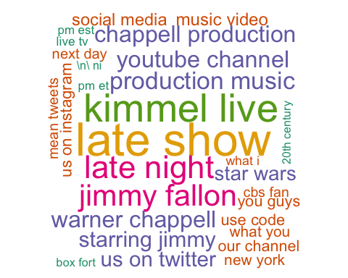
US-Description ‘kimmel live’ ‘jimmy fallon’ ‘warner chappell’ ‘production music’

Slide 14
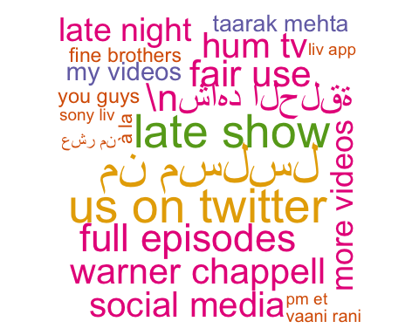
CA-Description ‘warner chappell’ ‘late show’ ‘social media’ other language

Slide 15
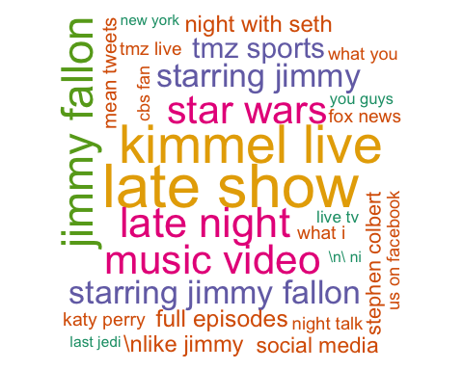
UK-Description ’jimmy fallon’ ‘kimmel live’ ‘music video’ ‘star wars’

Slide 16
IN-Description ’full episode’ ‘current affairs’ ‘ozee app’

Slide 17
Negative words vs. Positive words in description

Slide 18
The distribution of sentiment score of description by countries

Slide 19
The End
QUESTIONS & COMMENTS

